Slide 1
2. Agile’s frameworks: Kanban and Scrum
(7 hours)

Slide 2
Summary
2.1 Kanban and Scrum compared (1.5 hours)
2.2 Agile in ‘non-development’ processes (2.5 hours)
2.3 Roles and rituals (2 hours)
2.4 Focus on Scrum Master certifications (1 hour)

Slide 3
2.1 Kanban and Scrum compared (1.5 hours)

Slide 4
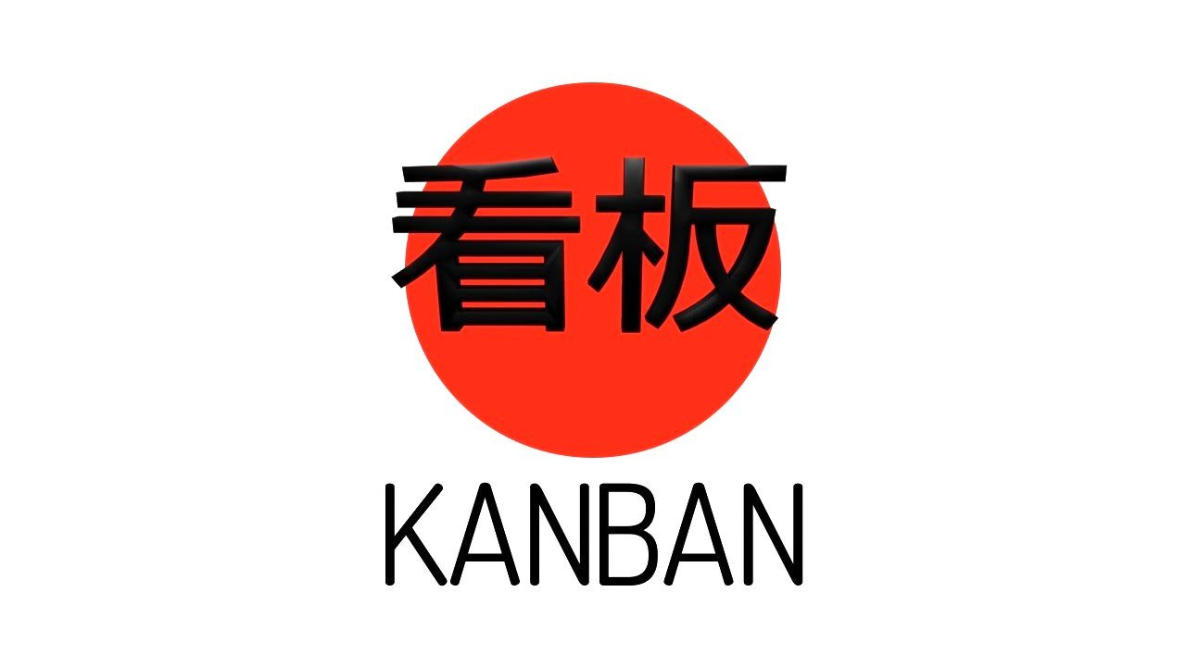

Kanban VS Scrum
Within the Agile approach there are two different 'frameworks' (also called 'methods' or 'methodologies') that are fundamental: Kanban and Scrum

Slide 5
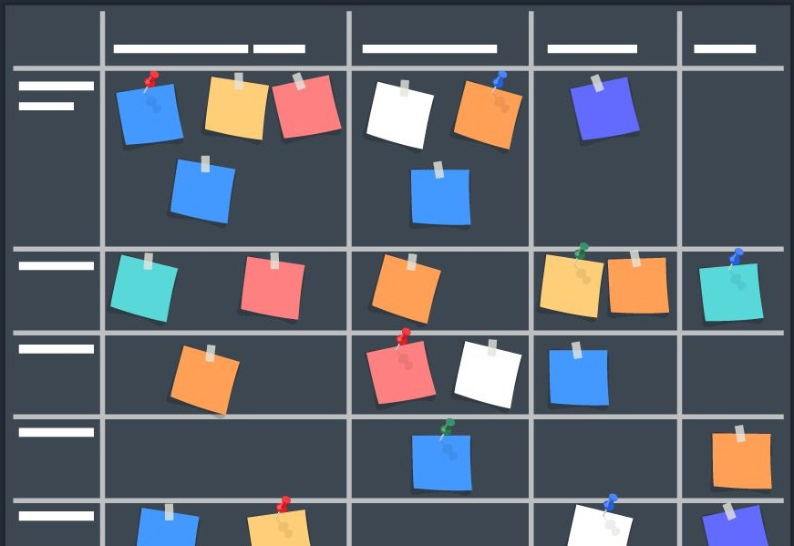
Commonalities between Kanban and Scrum
1. Both are known for their material display: the 'Board'

Slide 6
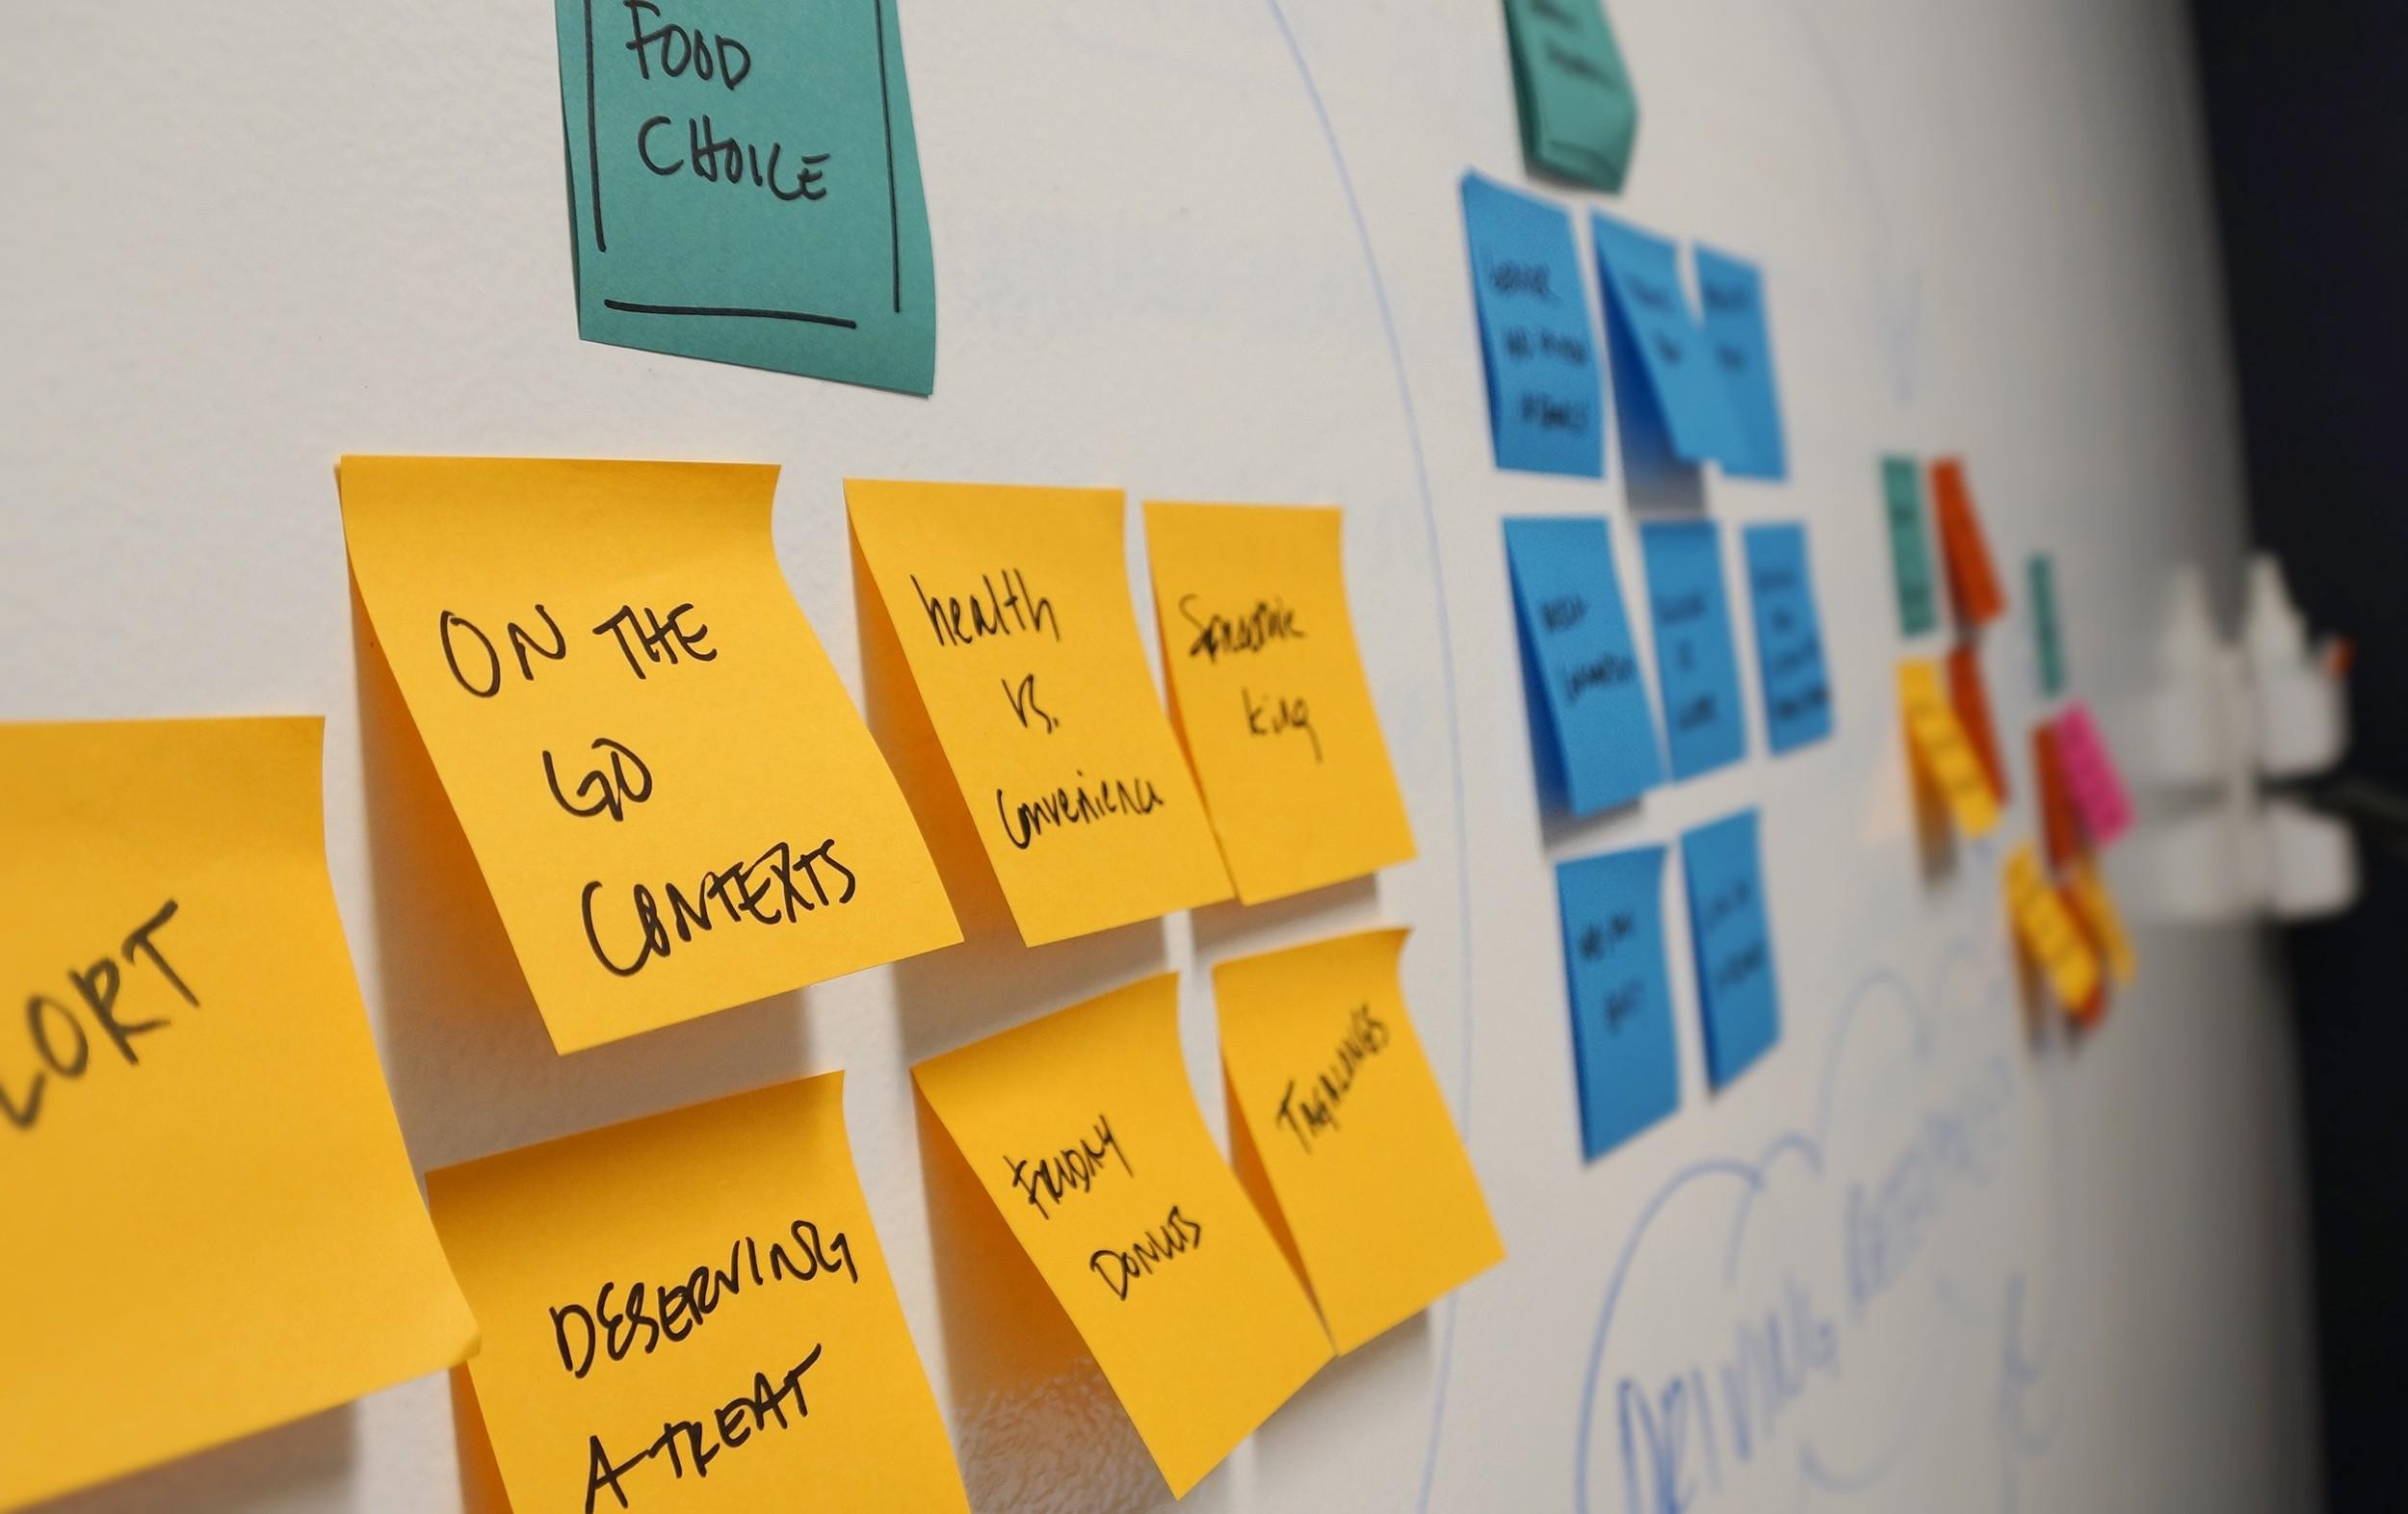
Commonalities between Kanban and Scrum
2. Both Kanban Boards and Scrum Boards use the famous 'post-its' (cards) to communicate the progress of work

Slide 7

Commonalities between Kanban and Scrum
3. Progress is indicated by 'Columns' through which the different cards pass, from left to right

Slide 8
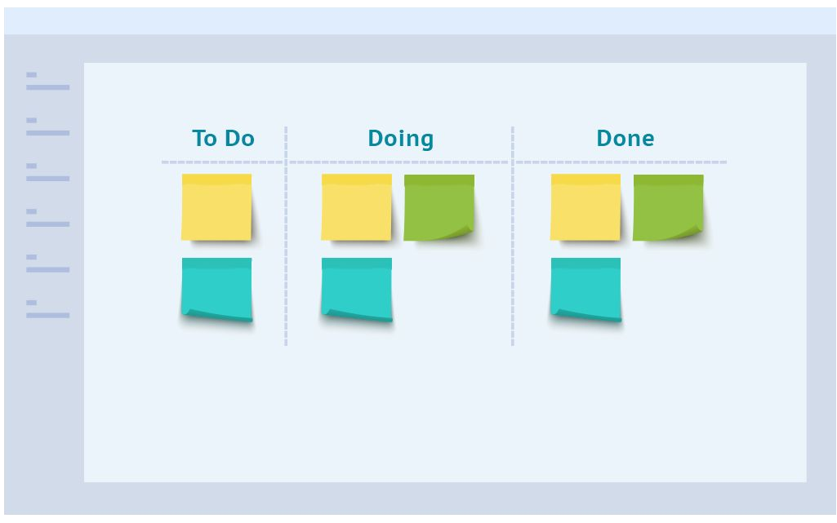
Commonalities between Kanban and Scrum
4. ToDo - Doing - Done are the 'canonical' (Status) columns, but teams usually expand the number and type of statuses according to their needs.

Slide 9

Commonalities between Kanban and Scrum
5. The cards that appear on the board can be of different categories

Slide 10
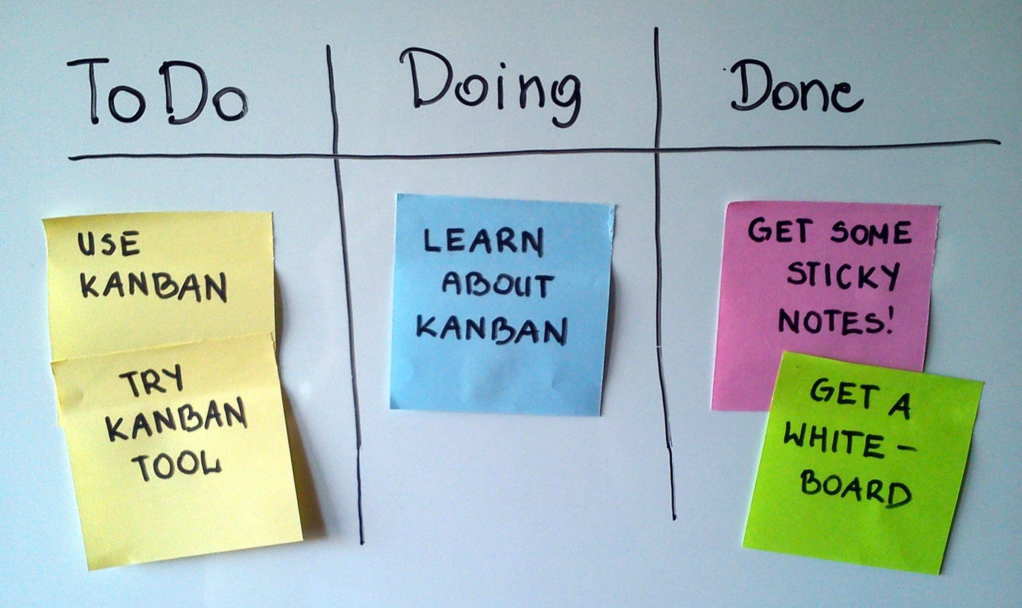
Anatomy of an agile board
STATUS
Columns identifying the different processing stages
CARD TYPE
Identification of different task categories
CARD
Description of a portion of the work, also called Task, or Issue

Slide 11
Features of the Kanban board
A Kanban board monitors the ﬂow of the process by limiting the number of ongoing work activities.
The number of ongoing activities is small enough to avoid unimportant tasks, but large enough to reduce idle personnel.
Kanban is like a basketball game: a completed activity equals one point and the team tries to minimise the time between shots.

Slide 12
Features of the Scrum board
A Scrum board tracks the work done within fixed duration cycles, called 'Sprints'. A Sprint is a short, consistent and repetitive period of time.
The length of the Sprint is short enough to keep the team focused, but long enough to provide an appreciable increment of work for the customer.
Scrum is like an exam at university: you have to complete a series of exercises in a certain time period, within which no other activities are allowed.

Slide 13
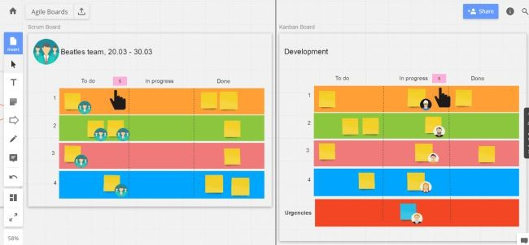
Kanban VS Scrum
Work in progress limits
Scrum limits the WIP per iteration. The team must commit to the number of tasks in the Sprint. Nothing prevents having all cards in the "In Progress" status simultaneously.
Kanban limits the WIP per status. The number "5" in the "In Progress" column means that there should be no more than 5 cards in that workflow status.
Work In Process: a term used to indicate the number of parts (or batches) processed simultaneously within a production system. This is the material leaving one stage of the process waiting to be processed by the next.
SCRUM
KANBAN

Slide 14
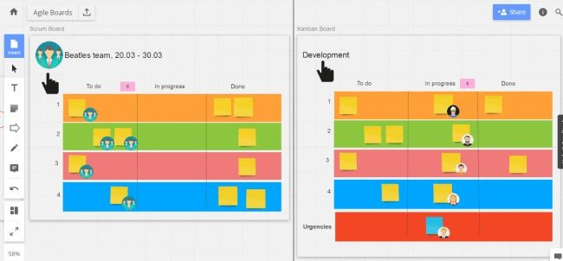
Kanban VS Scrum
Owners
SCRUM
KANBAN
In Scrum, the board is always 'owned' by a single Scrum team (= cross-functional group of people with all the necessary skills to successfully complete each Sprint activity).
Kanban board does not need to be owned by a specific team since it is mostly dedicated to a (monofunctional) workflow.

Slide 15
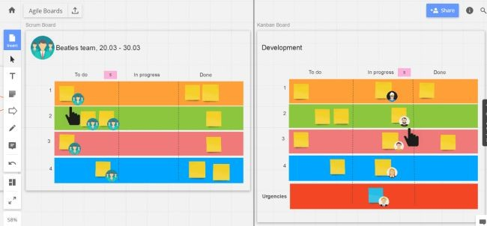
Kanban VS Scrum
Task devotion
SCRUM
KANBAN
In Scrum, the entire team converges on each task.
In Kanban, each person is responsible for his or her own ﬂow of work. However, Kanban has a culture of scarce resources to help solve the so-called 'bottlenecks' → If one person has completed his or her task but there is something complicated in a column of the board (a bottleneck, in fact), he or she can choose whether to help his or her partner complete the task or take another task from the queue.

Slide 16
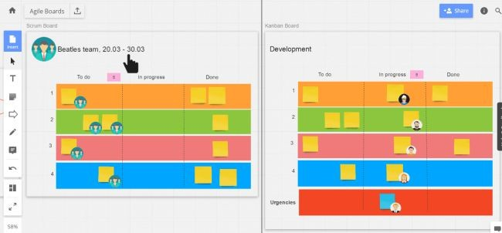
Kanban VS Scrum
Changes within an iteration
SCRUM
KANBAN
In Scrum, the team should not add any new cards on the board during the Sprint. The number of cards is defined during the planning session, before the start of the iteration.
On the other hand, a Kanban board can be changed at any time; the only limitation concerns ongoing activities → As soon as a card moves from 'In Progress' to 'Done', capacity is freed up to be used for a new activity/card (continuous flow).

Slide 17
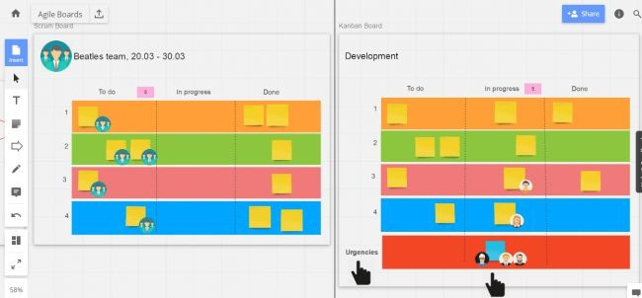
Kanban VS Scrum
Urgencies (tickets)
SCRUM
KANBAN
Thanks to previous analysis, planning, sizing and prioritisation sessions, the Scrum team rarely has to deal with unforeseen urgencies.
In Kanban, an 'Urgencies' line (also called Swim Lane) can be inserted → Cards that end up there identify an unpredictable urgent task or a task that arises to solve a 'bottleneck' card. They have the highest priority, so some team members converge on it to complete it as soon as possible.

Slide 18
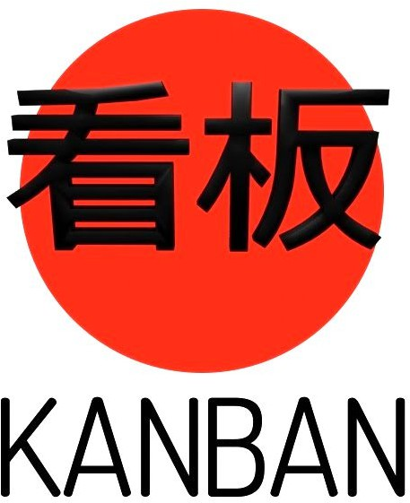
Kanban VS Scrum
Roles
Scrum master
Product Owner
Team Members
Not predefined
Convergence when a member is in trouble

Slide 19
Kanban VS Scrum
Due Dates
Sprint plan (time-box)
Continuous flow
Event-based

Slide 20
Kanban VS Scrum
Priorities
New tasks only allowed when the entire 'batch' is completed
New tasks only allowed when previous ones are completed

Slide 21
Kanban VS Scrum
Modifications
Strongly discouraged
Permitted (encouraged)

Slide 22
Kanban VS Scrum
Best for…
Stable priorities that vary less in the processing cycle
More variable scope of work

Slide 23
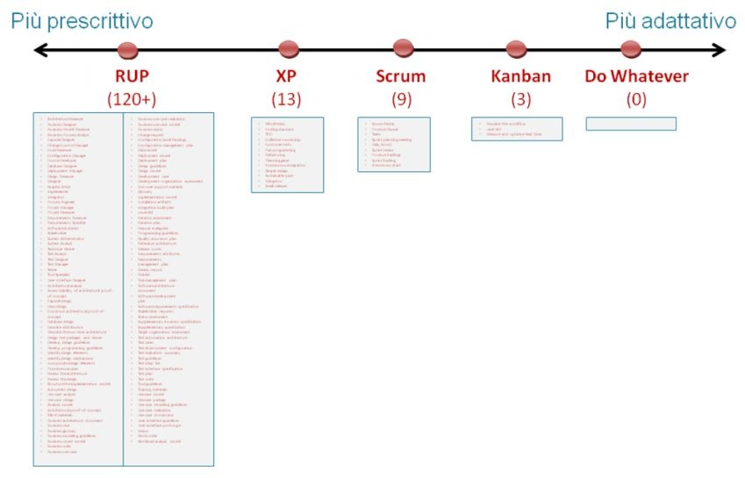
Kanban VS Scrum
'Prescriptiveness scale' of agile frameworks
More prescriptive
More adaptive
FRAMEWORK AND NUMBER OF PRESCRIBED RULES:
RUP (Rational Unified Process): over 120 (including roles, rituals, artefacts and other rules)
XP (eXtreme Programming): 13
SCRUM: 9
KANBAN: 3 (visualise workflow, limit Work In Process, continuously improve)

Slide 24
2.2 Agile in ‘non-development’ processes (2.5 hours)

Slide 25
Which processes?
Processes, depending on their role within the organisation, can be classified in different ways. Starting from Stalk and Hout's definition, we can identify:
OPERATIONAL PROCESSES
SUPPORT PROCESSES
CONTROL PROCESSES

Slide 26
Which processes?
Processes, depending on their role within the organisation, can be classified in different ways. Starting from Stalk and Hout's definition, we can identify:
OPERATIONAL PROCESSES
SUPPORT PROCESSES
CONTROL PROCESSES

Slide 27
Which processes?
1) OPERATIONAL PROCESSES
They directly concern the creation of products or services. They are the processes that, more than others, directly provide added value to the product/service.
E.g. design, production, sales.

Slide 28
Which processes?
2) SUPPORT PROCESSES
They support operational processes in order to make them more effective and efficient.
E.g. commercial management, information system, human resources, financial management, procurement, etc.

Slide 29
Which processes?
3) CONTROL PROCESSES
Processes that drive the entire Quality Management System.
E.g. review of the Quality Management System, definition of the organisation's objectives, measurement of results, development of strategies, etc.

Slide 30
Examples of processes that can be managed with agile
Ensuring the correct execution of a project (also in PA)
Selling
Manage customer communications (marketing activities, etc.)
Monitor customer satisfaction
Manage resources (manage financial transactions, process internal and external information reporting, fulfil legal obligations)

Slide 31
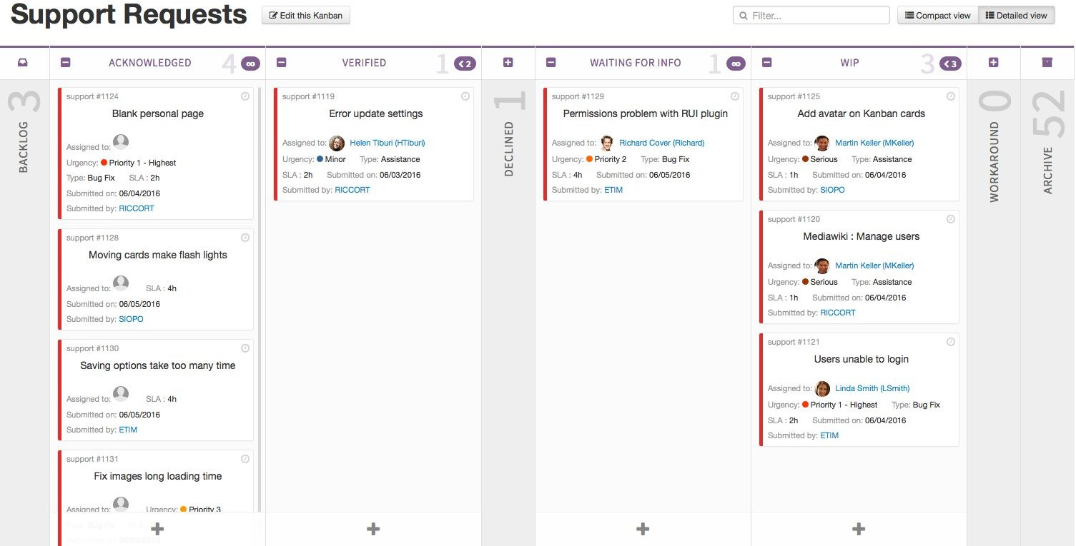
Agile board for after-sales management

Slide 32
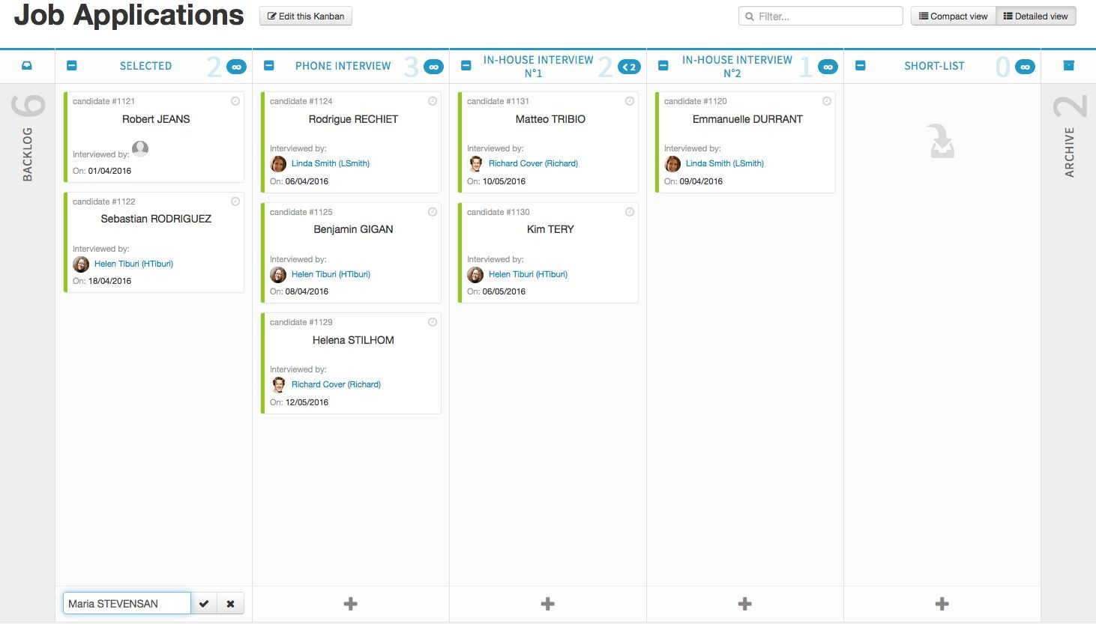
Agile board to manage personnel selection

Slide 33
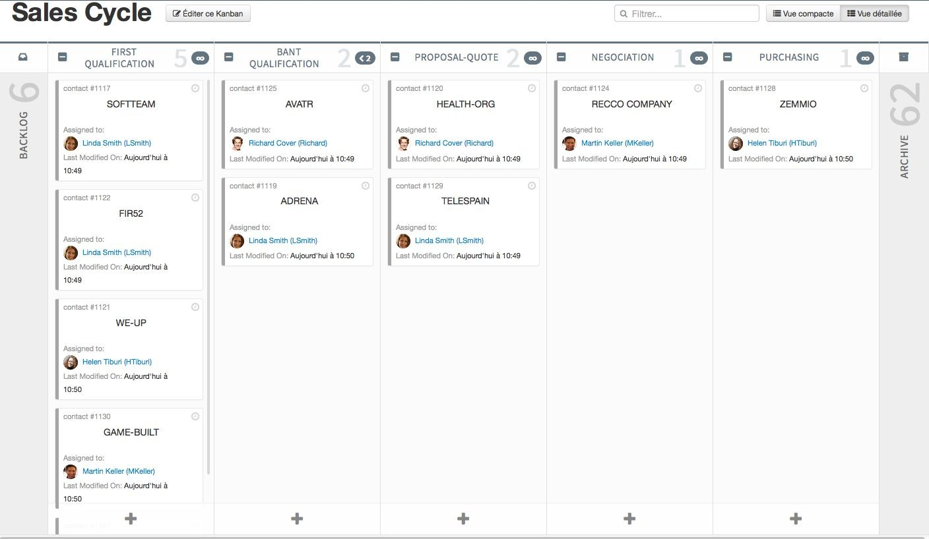
Agile board to manage sales

Slide 34
2.3 Roles and rituals (2 hours)

Slide 35
Roles
Role: set of behaviours, rights, duties, beliefs and norms related to and accepted by people in a certain social context
Product Owner
Scrum Master
Team members

Slide 36

Product Owner
Is responsible for the product/project
Adds new activities
Has the final say on the priority and order of activities

Slide 37

Scrum Master
Schedules meetings (rituals)
Supervises their proper functioning
Reminds the team of the "fundamentals" of the method

Slide 38

Team members
Make up the working group
They carry out a portion of the project activities

Slide 39
Product Owner VS Scrum Master
Product Owner: product development manager
Product Manager: responsible for strategy, roadmap, budget
Given the substantial overlapping of roles it is better to use only the Product / Project Manager.

Slide 40
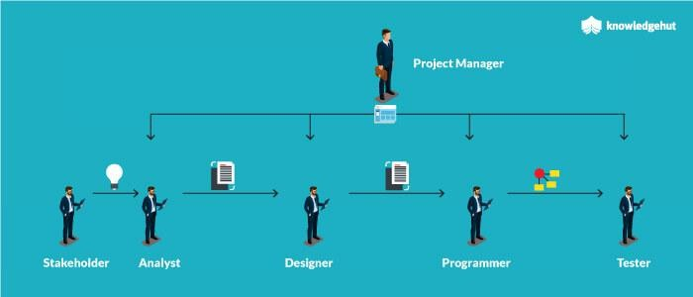
Product Owner VS Scrum Master

Slide 41
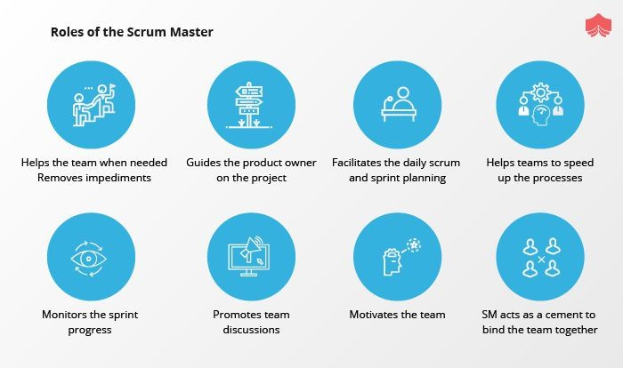
Product Owner VS Scrum Master

Slide 42
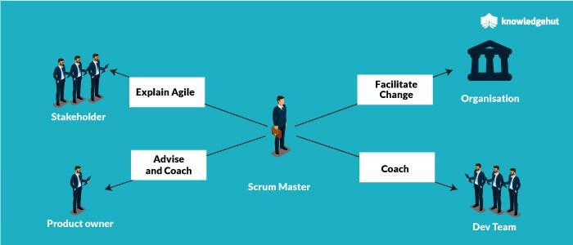
Product Owner VS Scrum Master

Slide 43
Rituals
Ritual: sequence of activities involving gestures, words and objects, performed in a given place and according to a predetermined sequence.
Sprint planning
Daily stand-up meeting
Sprint retrospective

Slide 44
Sprint planning
The entire team participates.
The product owner sets the highest project priorities.
The team asks questions that help break down the entire project into detailed tasks.
The team (not the product owner) determines the amount of work to be performed in the sprint (self-managed teams).
The session ends only AFTER defining one or more sprint goals (a short description of the goals to be achieved) and a sprint backlog (list of tasks to be performed).

Slide 45
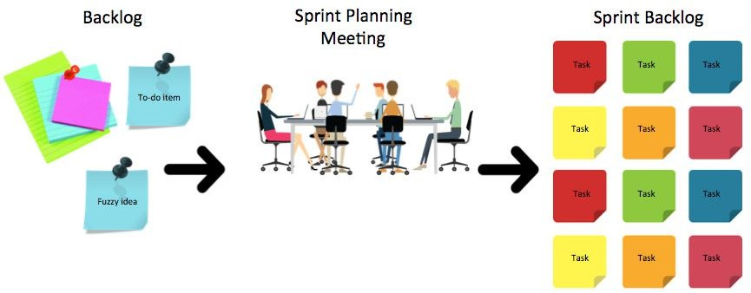
Sprint planning

Slide 46
Daily stand-up meeting
The daily standup meeting (or daily scrum) is the daily practice at the heart of agile, to be carried out in the same place and at the same time every day, preferably in the morning.
These meetings should last no longer than 15 minutes and are intended for all team members.
It is important that the meeting is focused more on status updates than on problem solving (which should instead concern only certain team members).
This practice dictates the pace of the project and keeps team members 'committed' to the goal.

Slide 47
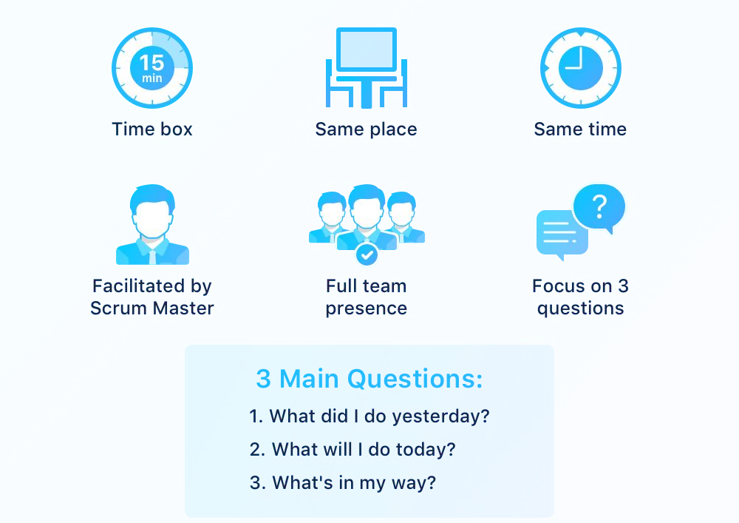
Daily stand-up meeting

Slide 48
Sprint retrospective
In the retrospective, the team looks for ways to improve the work from what happened during the sprint.
The whole team participates and it usually lasts one hour at the most.
Three questions are answered during the retrospective:
- what the team should start doing
- what the team should stop doing
- what the team should continue to do
The Scrum Master facilitates this ritual.

Slide 49
2.4 Focus on Scrum Master certifications (1 hour)

Slide 50
Scrum Master certifications
Here is a list of the most important and widely recognized Scrum Master certifications, including their issuing organizations, focus areas, and suitability for different levels of experience:
Certified ScrumMaster® (CSM)
Professional Scrum Master™ (PSM I, II, III)
SAFe® Scrum Master (SSM)
Scrum Master Certified (SMC®)

Slide 51
1. Certified ScrumMaster® (CSM)
Issuing Organization: Scrum Alliance (scrumalliance.org)
Level: Entry-level (ideal for beginners to Scrum or transitioning project managers)
Duration: 2-day course + online exam
Renewal: Every 2 years (requires Scrum Education Units - credits - and a fee)
Focus:
Scrum basics (roles, events, artifacts)
Facilitation, coaching, servant leadership
Responsibilities of a Scrum Master

Slide 52
2. Professional Scrum Master™ (PSM I, II, III)
Issuing Organization: Scrum.org (scrum.org)
Levels:
PSM I – Foundational (most popular)
PSM II – Intermediate (focus on real-world application)
PSM III – Advanced (difficult, essay-based)
Duration: no course required, self-study possible
Renewal: Lifetime certification
Focus:
Strong on Scrum theory and principles
Emphasizes deep understanding over rote memorization

Slide 53
3. SAFe® Scrum Master (SSM)
Issuing Organization: Scaled Agile, Inc. (scaledagile.com)
Level: Intermediate
Ideal for Scrum Masters working in enterprises using SAFe
Duration: 2-day course + online exam
Renewal: Annual (with fee)
Focus:
Scrum Master role in Scaled Agile Framework (SAFe)
PI (Program Increment) planning, agile at scale
Coordination across teams in larger organizations

Slide 54
4. Scrum Master Certified (SMC®)
Issuing Organization: SCRUMstudy (scrumstudy.com)
Level: Beginner to intermediate
Duration: 2-day course + online exam
Renewal: Every 3 years (requires a fee)
Focus:
Scrum lifecycle
Roles and responsibilities
Real-world scenarios
Criticism: Less recognized compared to CSM and PSM

Slide 55
Scrum Master certifications - Comparison Summary
Certification | Organization | Level | Renewal | Exam Required | Highly Recognized
CSM | Scrum Alliance | Entry | Yes | Yes | ✅✅✅
PSM I | Scrum.org | Entry | No | Yes | ✅✅✅
PSM II/III | Scrum.org | Advanced | No | Yes | ✅✅
SSM | Scaled Agile | Intermediate | Yes | Yes | ✅✅
SMC | SCRUMstudy | Beginner | Yes | Yes | ✅ (less common)

Slide 56
Choosing the right Scrum Master Certification
CSM
Best for beginners Widely recognized
PSM I
Strong theory focus No renewal
PSM II/III
Deep expertise Challenging exams
SSM
Agile at Scale Great for enterprise
SMC
Accessible Less recognized
New to Scrum? → Start with CSM or PSM I
Want a deep understanding + no renewal? → Choose PSM I
Working in enterprise/large teams? → Go for SSM
Interested in long-term Scrum career? → Progress to PSM II/III or SAFe

